Slide 1



Blood Pressure
SERVERLESS COMPUTING FOR IOT
BY
PROF Vittorio SCARANO
SUPERVISOR
Giuseppe D'AMBROSIO
ABDUL AZIZ LAGHARI
Notes:
1

Slide 2
PROBLEM AREA
when your blood pressure stays high over time, it causes the heart to pump harder and work overtime, possibly leading to serious health problems such as heart attack, stroke, heart failure, and kidney failure.

Slide 3
How Blood Pressure Affects Our Body
Hypertension, or high blood pressure, is when your blood travels through blood vessels with more force than is considered healthy. When blood pressure is high, it can damage artery and blood vessel walls over time. This leads to dangerous complications and even death if left untreated.

Slide 4
How Blood Pressure Affects Our Body
Blood pressure is measured by systolic over diastolic pressure. Systolic refers to the pressure when the heart is beating, and diastolic refers to the pressure when the heart rests between beats. For an average adult, a blood pressure reading is considered normal if it’s below 120/80 mmHg.

Slide 5
PURPOSE
The purpose of this project is to observe the Blood Pressure and monitor those values on an independent platform so we can get information about the Human body’s Blood Pressure which saves Humans from many Health issues including Death too.

Slide 6
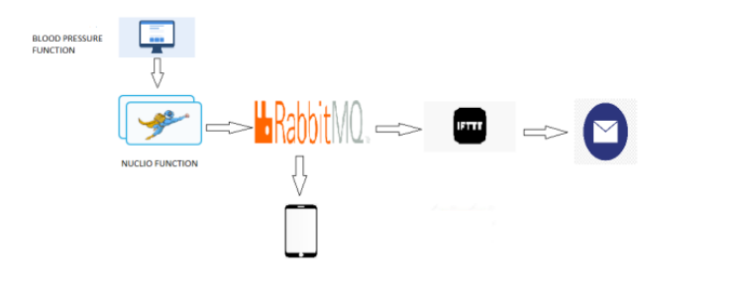
ARCHITECTURE DIAGRAM

Slide 7
Services
Docker
Docker is an open platform for developing, shipping, and running applications. Docker enables you to separate your applications from your infrastructure so you can deliver software quickly. With Docker, you can manage your infrastructure in the same ways you manage your applications.
RabbitMQ
RabbitMQ is open-source message-broker software that implements AMQP and has since been extended with a plug-in architecture to support MQTT and other protocols.
Node.js
Node.js is an open-source, cross-platform, back-end JavaScript runtime environment that runs on the V8 engine and executes JavaScript code outside a web browser

Slide 8
Services
NUCLIO DASHBOARD
Nuclio is a high-performance "serverless" framework focused on data, I/O, and compute-intensive workloads, Nuclio is extremely fast a single function instance can process hundreds of thousands of HTTP requests or data records per second.
MQTIZER
MQTT stands for Message Queue Telemetry Transport. It is a publish/subscribe, extremely simplistic and lightweight messaging protocol, devised for constrained devices and low-bandwidth, high-latency, or unreliable networks.
IFTTT
If This, Then That is a private commercial company that runs services that allow a user to program a response to events in the world

Slide 9
LIBRARIES
The Advanced Message Queuing Protocol (AMQP) is an open standard for passing business messages between applications or organizations.
Requests allow you to send HTTP/1.1 requests extremely easily. There’s no need to manually add query strings to your URLs or to form-encode your POST data.
MQTT is a lightweight publish-subscribe mode messaging protocol designed for IoT applications in low-bandwidth and unstable network environments. MQTT is based on the publish/subscribe paradigm and works on the TCP/IP protocol family.

Slide 10
IMPLEMENTATION
DOCKER
We install docker desktop on windows
NUCLIO :
After Installing the docker then we install Nuclio serverless platform by using the docker command in the command prompt.
RABBIT MQ :
We install RabbitMQ by using the given Docker command in the command prompt.
IFTTT :
We make an account and make applets on IFTTT webhooks and then we create events on IFTTT applets through webhooks.

Slide 11
IMPLEMENTATION
To generate the queues on RabbitMQ we deploy the given function on the Nuclio dashboard by setting IP and triggers.
The deployed function on the Nuclio dashboard will generate queues on RabbitMQ of the temperature data function.
MQTIZER android application displays the data on Smartphone by setup the IP that will generate messages on phone.
IFTTT creates events on applets through webhooks and sends email.

Slide 12

Thank You!
Notes:
12

